Slide 1



SQL INJECTION PREVENTION SYSTEM IN ONLINE SHOPPING
MURUGAPPA POLYTECHNIC COLLEGE
Sathyamurthy Nagar, Chennai-600 062.
(An Academically Autonomous Institution)
DEPARTMENT OF COMPUTER ENGINEERING
PROJECT REPORT ON
Submitted By,
MYTHRIYAN R - 1912270
NANDHA A - 1912272
NAVEEN KUMAR D - 1912276
RAJESH S - 1912282
Under the guidance of,
Mrs. E. Nambirani, B.E. Lecturer, Department of Computer Engineering

Slide 2
SYNOPSIS
An online shop that allows users to check for different cloths available at the online store the project consists of a list of cloths display in various materials and designs. The users may browse through these products as per categories. If the user likes a product. He/she can add it to his/her shopping cart.
Once a user wishes to checkout, he must register on the site first. Once the user makes a successfully transaction, the admin will get a report of his bought projects. The objective of this project is to develop a secure path for transaction done by the user.
Using AES (Advance Encryption Standard) encryption technique, the transaction and user account details can be made secure. AES encryption is also used to encrypt the user’s card and password information while transaction and to prevent SQL injections in the website.

Slide 3
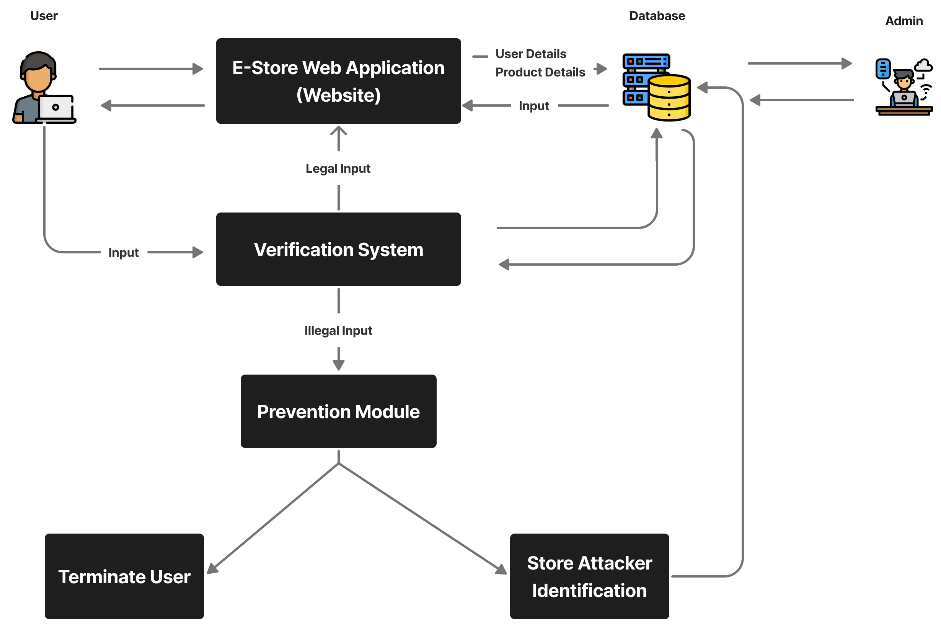
SYSTEM ARCHITECTURE

Slide 4
MODULES DESCRIPTION
Account Validation
Electronic Store Web Application
User Input Verification
SQL Injection Prevention

Slide 5
1. Account Validation
Users means an individual who is authorized customer to use the web form of the application.
In this project we have three types of users namely,
Legal Users
Hacker
Admin
Legal Users:
Legal users are the genuine customers of the application and the stick to the work flow of the application and experience the architecture and working.
Hacker:
Hacker is the threat to the application they attack the website and they take the information they need and they crack the whole system and make the application unresponsive.
Admin:
A website administrator is a technical professional who maintains websites. They typically have a thorough knowledge of web maintenance and web development that help a website function, as well as skills in front-end development that contribute to a website's appearance and usability.

Slide 6
2. Electronic Store Web Application
The E-Store web application is a platform that collects information from different sources into a single user interface and presents users with the most information for their content.
The E-Store web application allows you a convenient and secure way to view the content they require.

Slide 7
3. User Input Verification
Verification is the process for determining whether the user is legal or a hacker who perform some illegal activity in the E-Store web application verification system has a direct contact with the user.
The E-Store web application and the database. It determines the user whether they are legal or hacker.

Slide 8
4. SQL Injection Prevention
SQL Injection prevention system is a fully backed algorithm that takes action on the hacker and make the prevention to the application by the hackers.
SQL Injection prevention system is also responsible for informing the admin about the attack.

Slide 9
How the SQL Injections Work
Query In Php:
$insert_newsletter_query = "INSERT INTO newsletter(newsletter_email) VALUES('$newsletter_email ')";
SQL Injection:
'); DELETE FROM newsletter WHERE ('1=1
Result:
$insert_newsletter_query = "INSERT INTO newsletter(newsletter_email) VALUES('$newsletter_email'); DELETE FROM newsletter WHERE ('1=1')";

Slide 10
How we find the SQL Injection
function escapeInjection($query, $sec){
$split = str_split($query);
$error_count = array();
$break_input = array();
for($i = 0; $i < count($split); $i++){
$sql_keywords = "' - ; # / ! * , = ( ) %";
if(strpos($sql_keywords, $split[$i]) !== false){
array_push($error_count, $split[$i]);
}
array_push($break_input, $split[$i]);
}
$fix_input = implode($break_input);
$fix_input = str_replace("'", "/", $fix_input);
$fix_input = str_replace("-", "-/", $fix_input);
$fix_input = str_replace(";", ";/", $fix_input);
$fix_input = str_replace("#", "#/", $fix_input);
$fix_input = str_replace("/", "//", $fix_input);
$fix_input = str_replace("!", "!/", $fix_input);
$fix_input = str_replace("*", "*/", $fix_input);
$fix_input = str_replace(",", ",/", $fix_input);
$fix_input = str_replace("=", "=/", $fix_input);
$fix_input = str_replace("(", "(/", $fix_input);
$fix_input = str_replace(")", ")/", $fix_input);
$fix_input = str_replace("%", "%/", $fix_input);
if(count($error_count) >= 3){
prevent_mode($fix_input, $sec);
}
return $fix_input;
}

Slide 11
How we prevent the SQL Injection
function prevent_mode($fix_query,$pre_sec){
global $connection;
global $current_date;
global $fetch_user_name;
global $fetch_user_email;
$prevent_sec = $pre_sec;
$curr_page_name = basename($_SERVER['PHP_SELF']);
if(isset($_SESSION['sql_user_logino'])){
global $login_sessiono_user_id;
$prevent_query = "INSERT INTO prevent(prevent_user_id,prevent_time,prevent_attack, prevent_page, prevent_section, prevent_user_name, prevent_user_email) VALUES($login_sessiono_user_id, '$current_date', '$fix_query', '$curr_page_name', '$prevent_sec', '$fetch_user_name', '$fetch_user_email')";
$prevent_result = mysqli_query($connection, $prevent_query);

Slide 12
How we prevent the SQL Injection
$block_user_query = "DELETE FROM users WHERE users_id = $login_sessiono_user_id";
$block_user_result = mysqli_query($connection, $block_user_query); if(!$block_user_result){
alertBox("Something went wrong");
}else{
alertBox("Module Prevented");
alertBox("User terminated");
}
}else{
$prevent_query = "INSERT INTO prevent(prevent_time, prevent_attack, prevent_page, prevent_section) VALUES('$current_date', '$fix_query', '$curr_page_name', '$prevent_sec')";
$prevent_result = mysqli_query($connection, $prevent_query);
if(!$prevent_result){
alertBox("Something went wrong");
}else{
alertBox("Module Prevented");
}
} die();
}

